Slide 1
Sequence to Sequence Models and Machine Translation
Sapan H Mankad

Slide 2
DISCLAIMER
The contents in this presentation are compiled from various sources openly available on internet. The author thanks all the contributors for sharing their work in public domain.

Slide 3
Sequence to Sequence Models

Slide 4
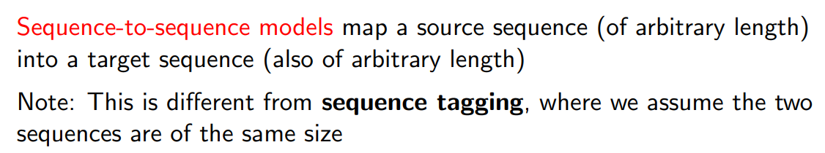
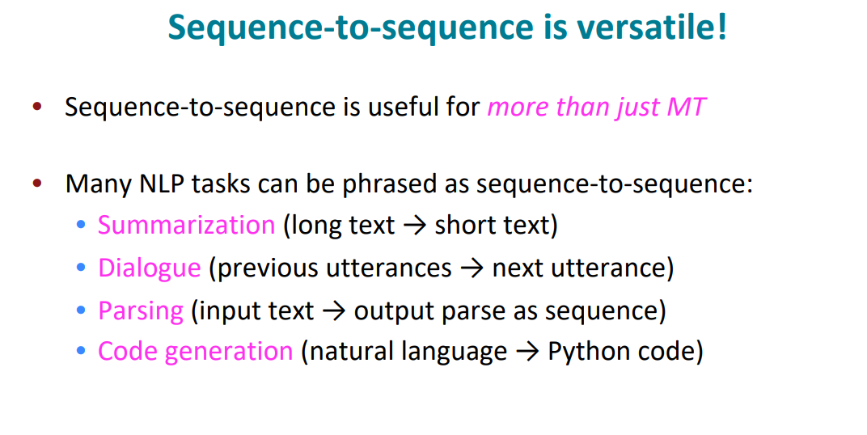

Slide 5
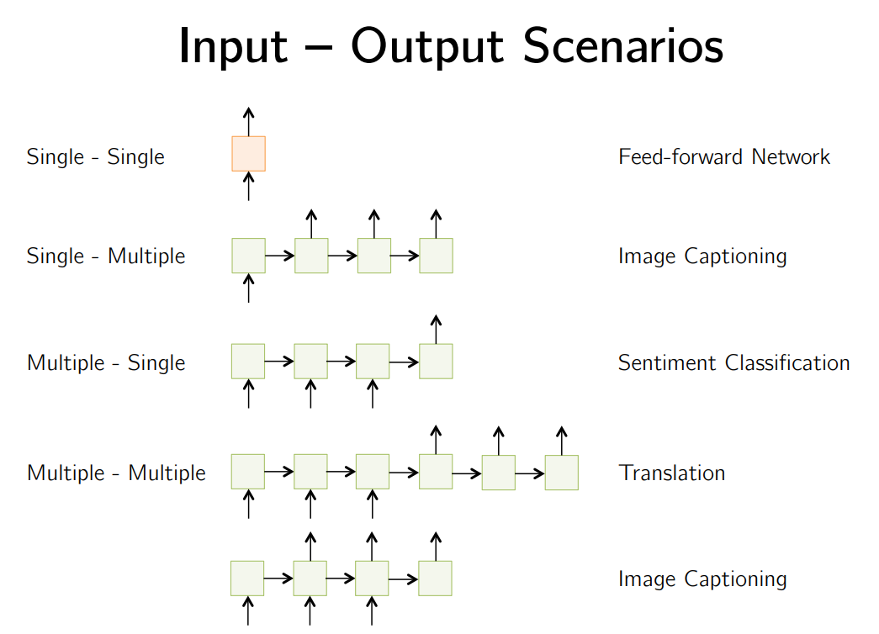

Slide 6
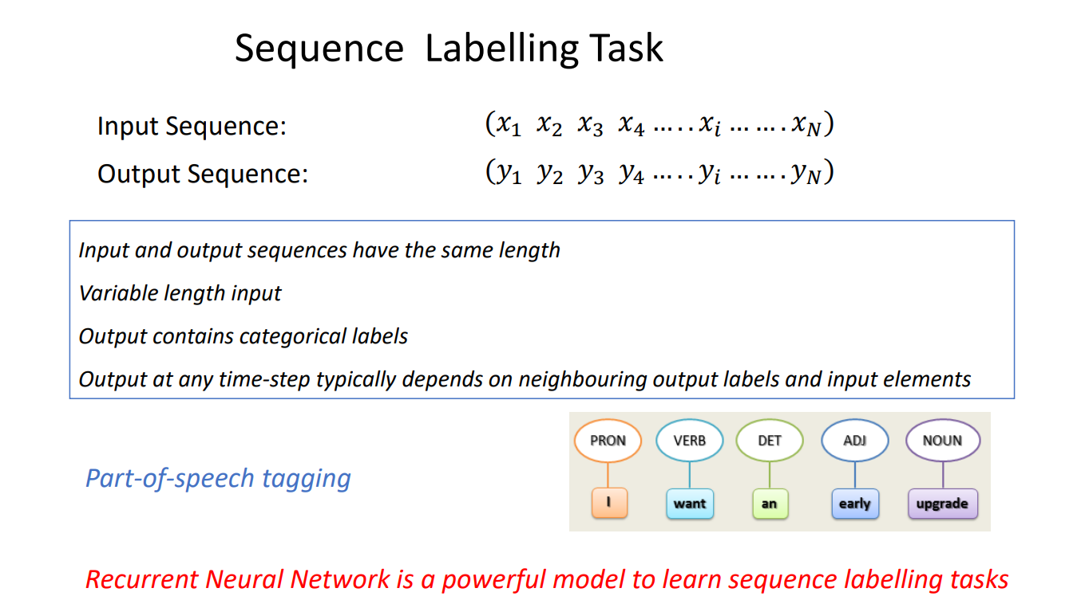

Slide 7
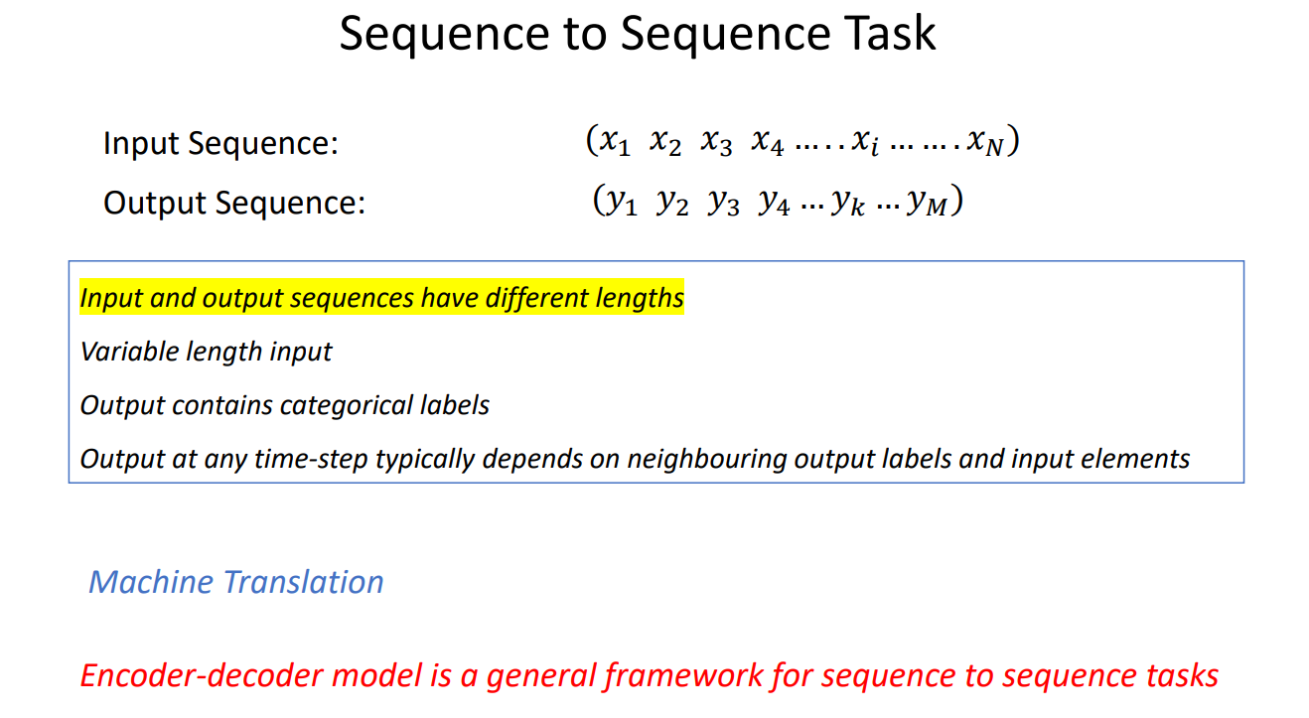

Slide 8
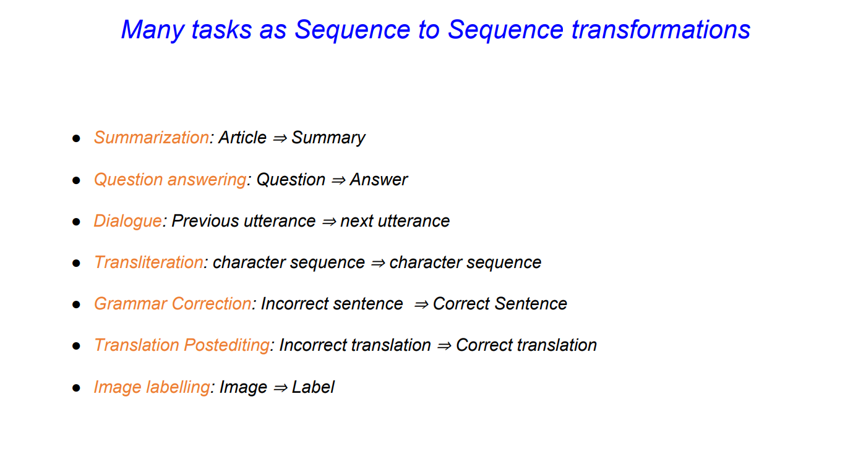

Slide 9
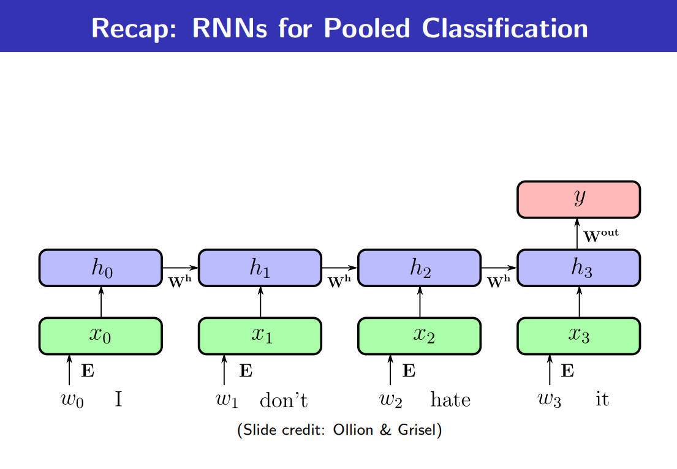

Slide 10
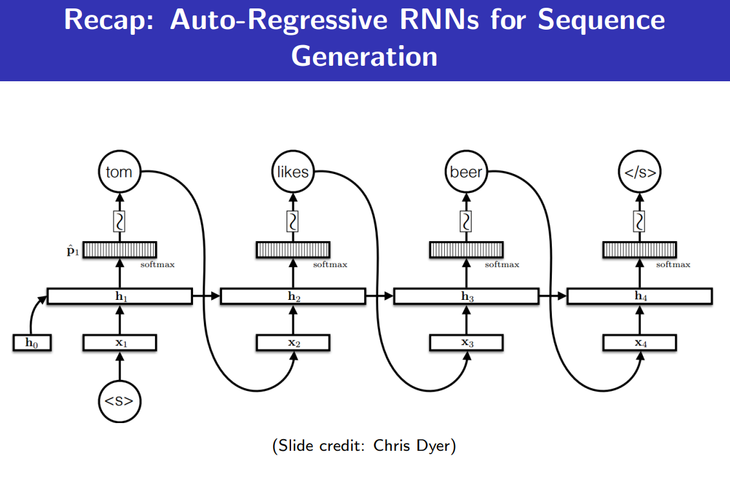

Slide 11
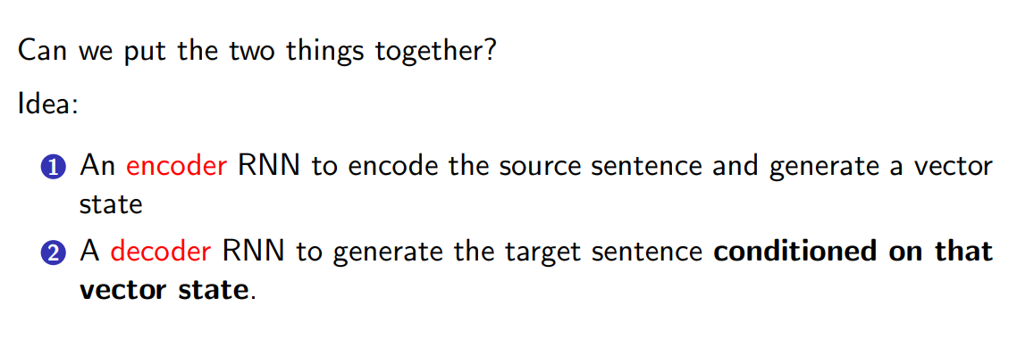
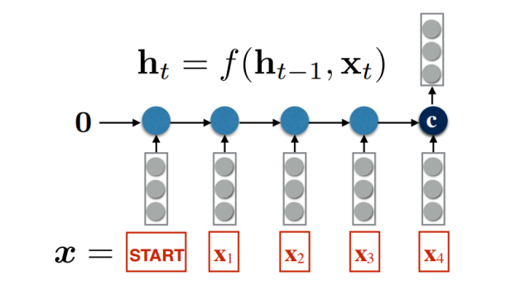

Slide 12
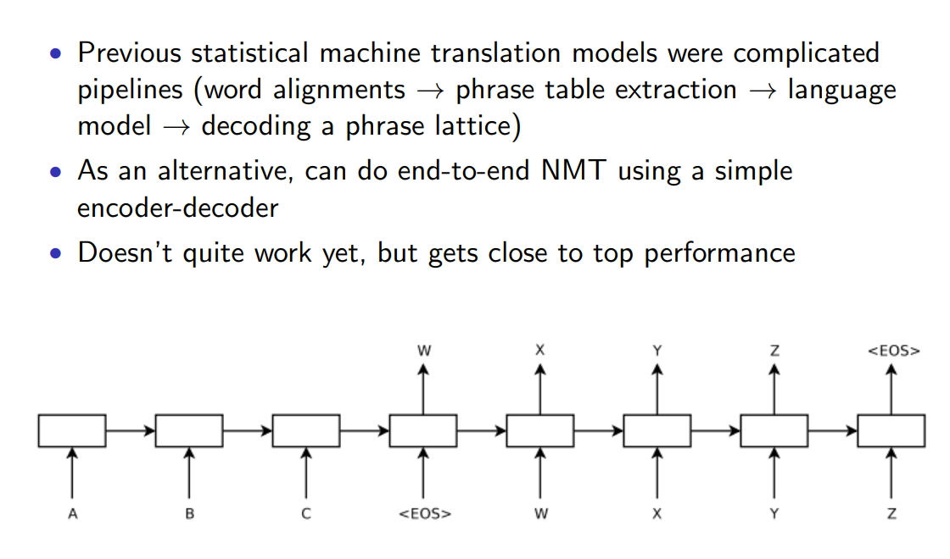

Slide 13
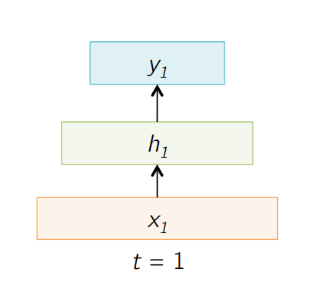

Slide 14
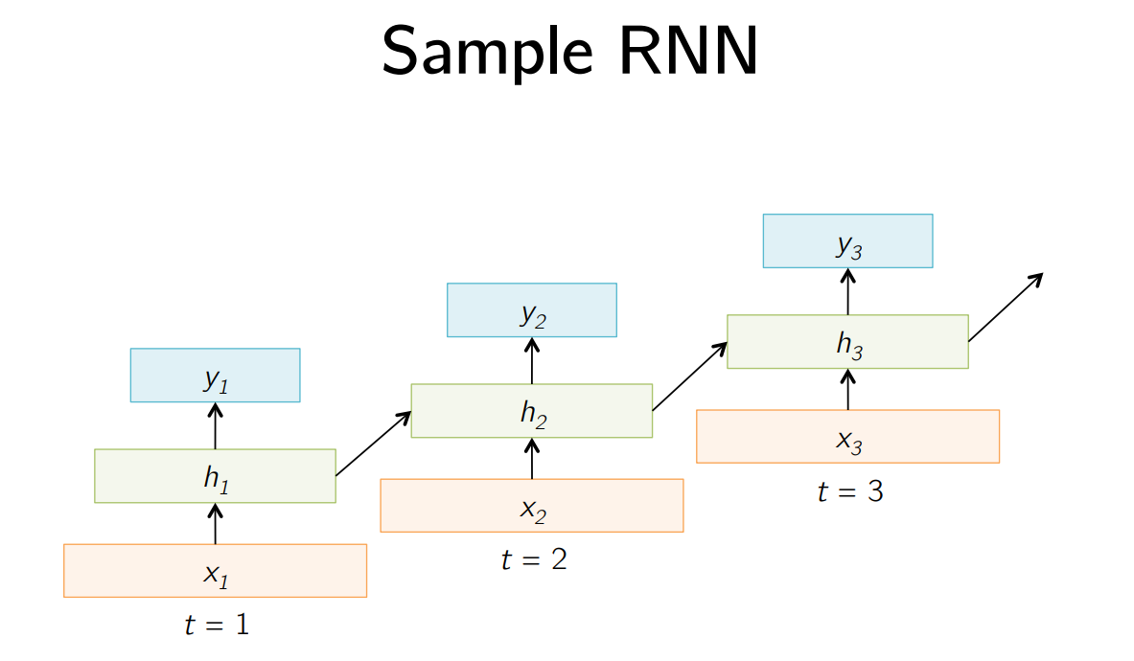

Slide 15
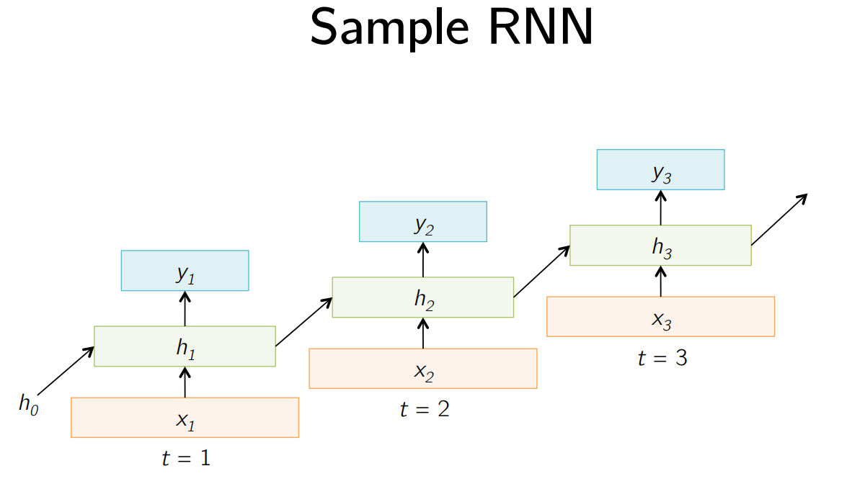

Slide 16
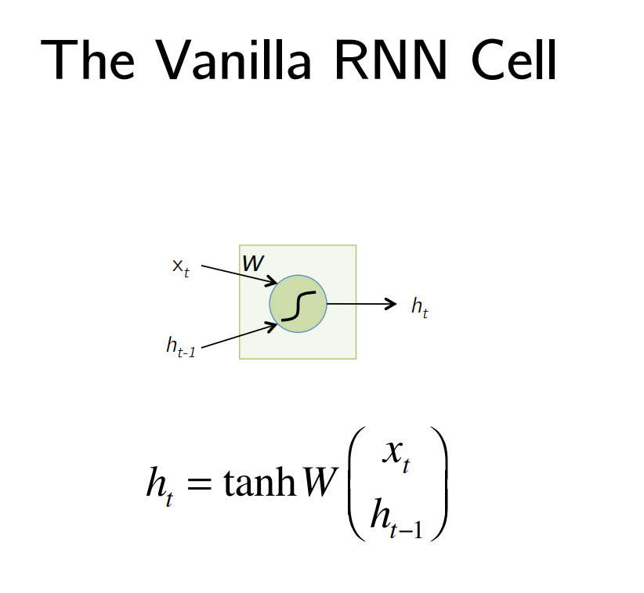

Slide 17
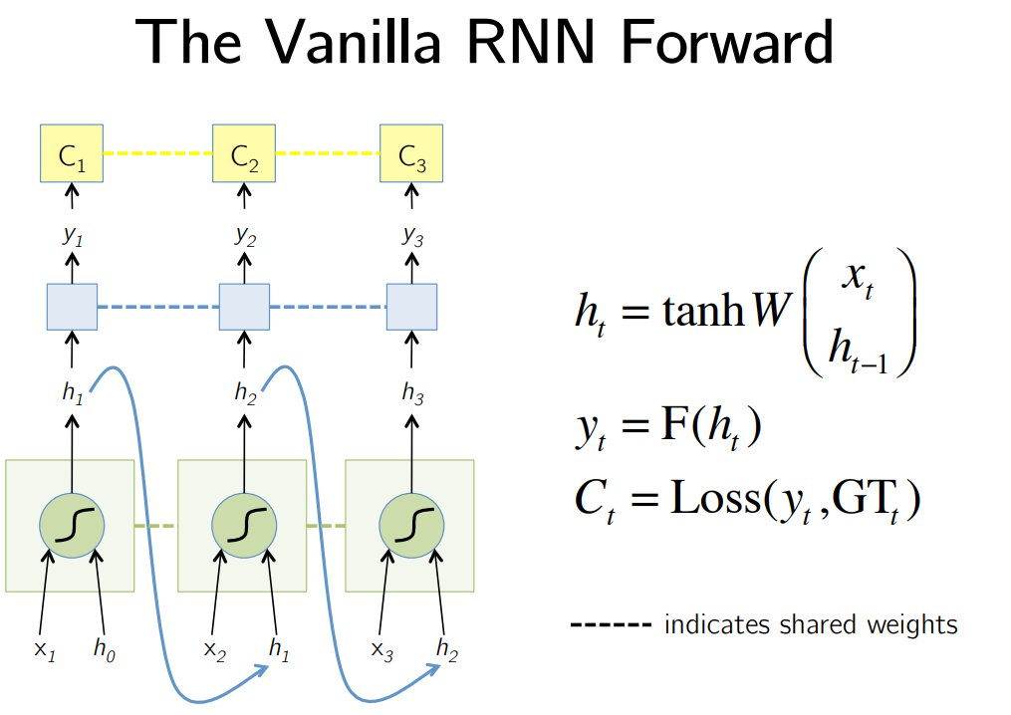

Slide 18
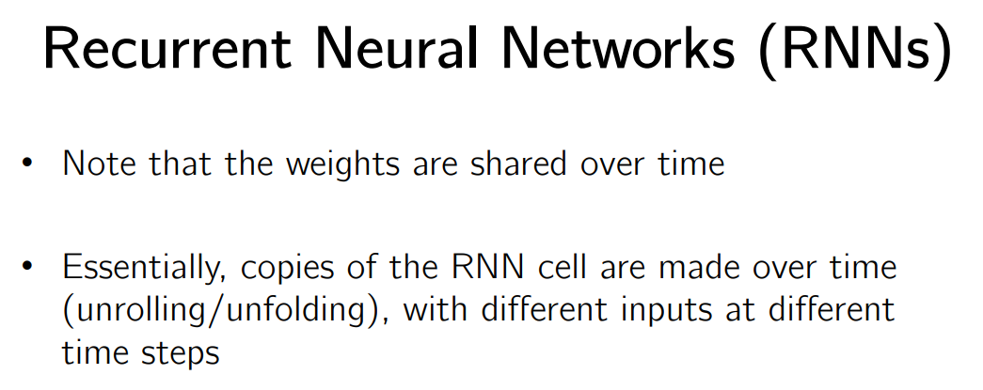

Slide 19
Machine Translation (MT)

Slide 20
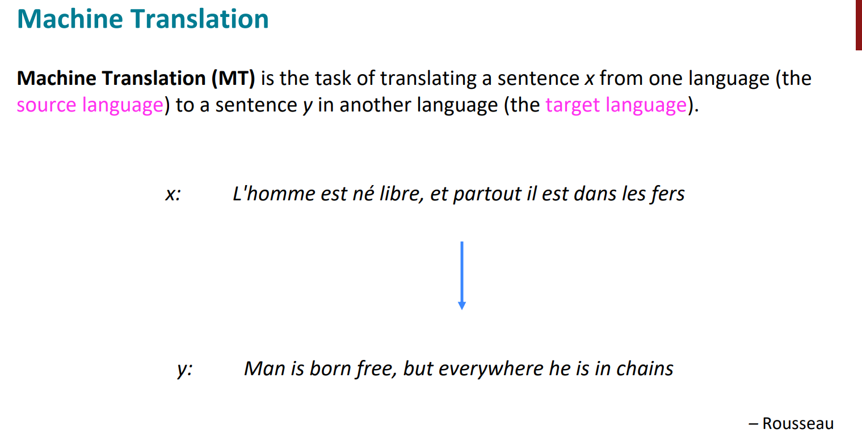
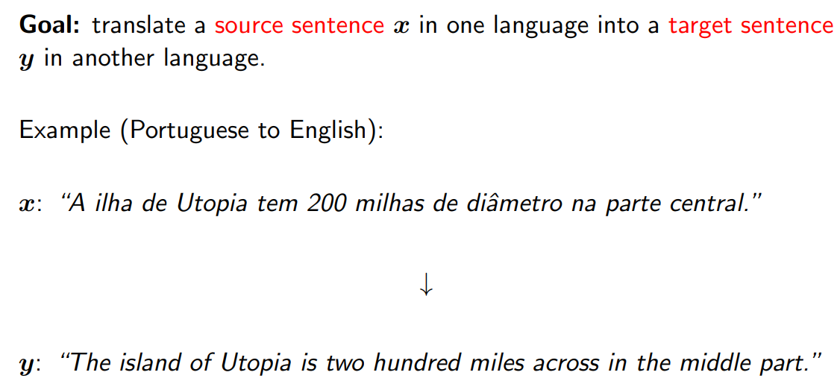

Slide 21
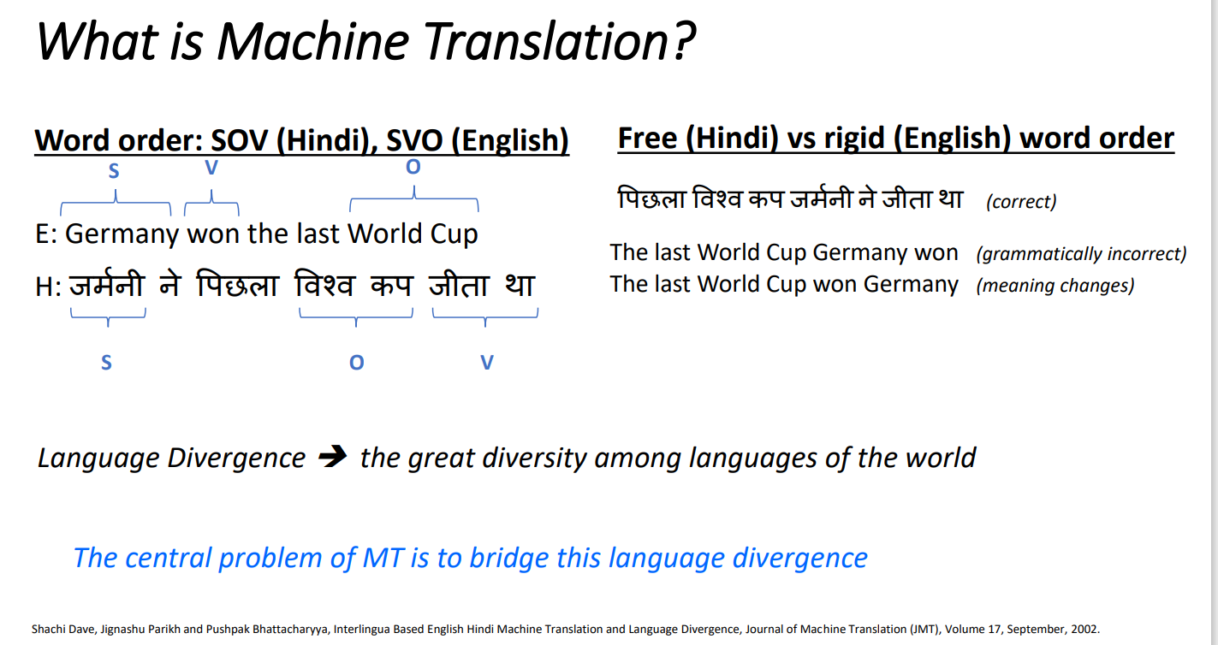

Slide 22
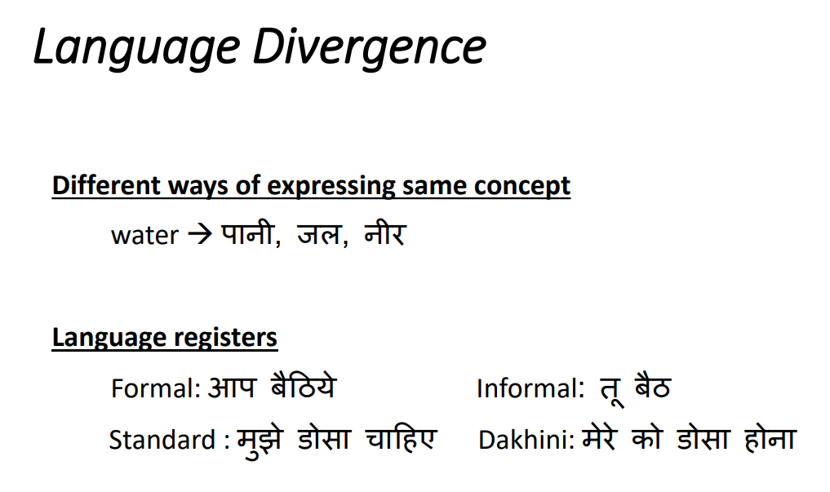

Slide 23
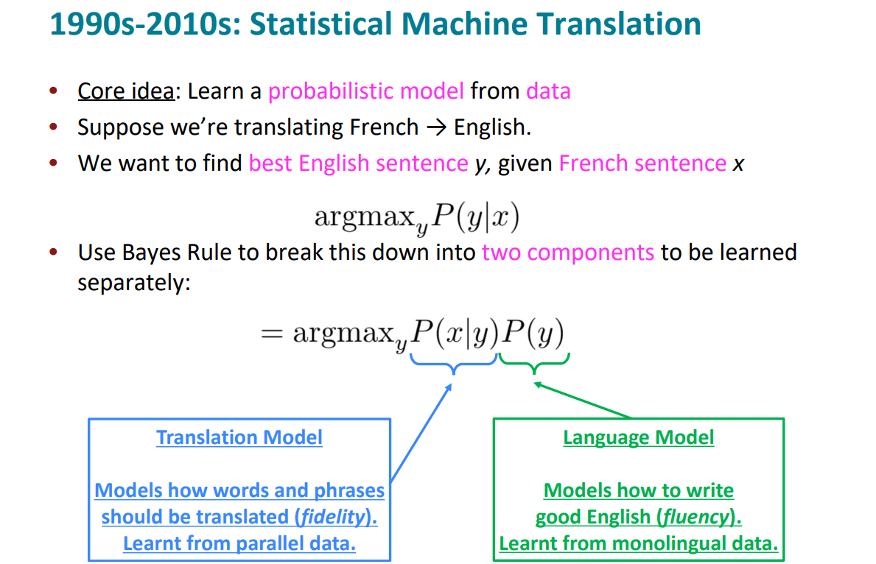
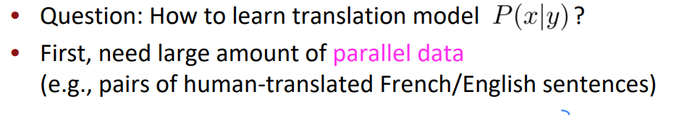

Slide 24
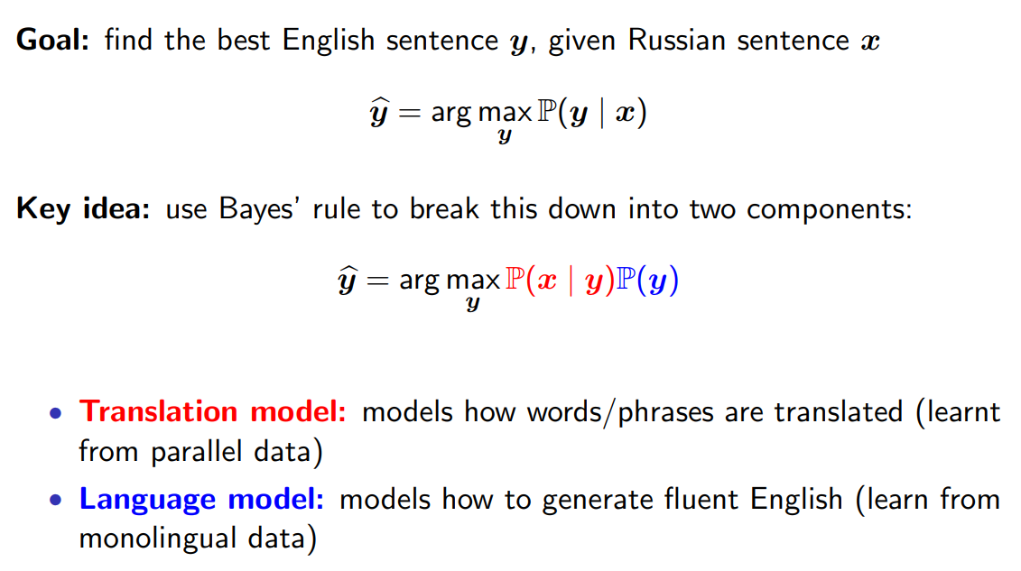
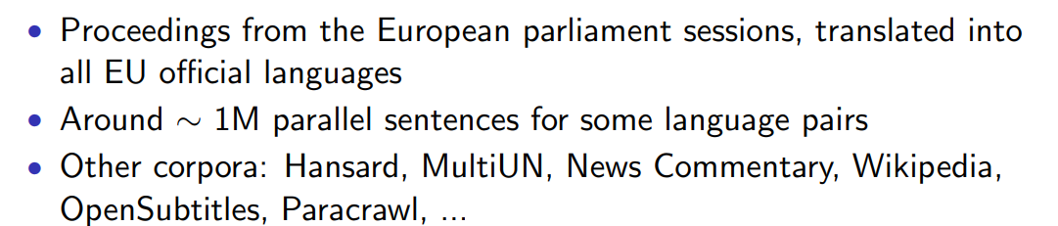

Slide 25
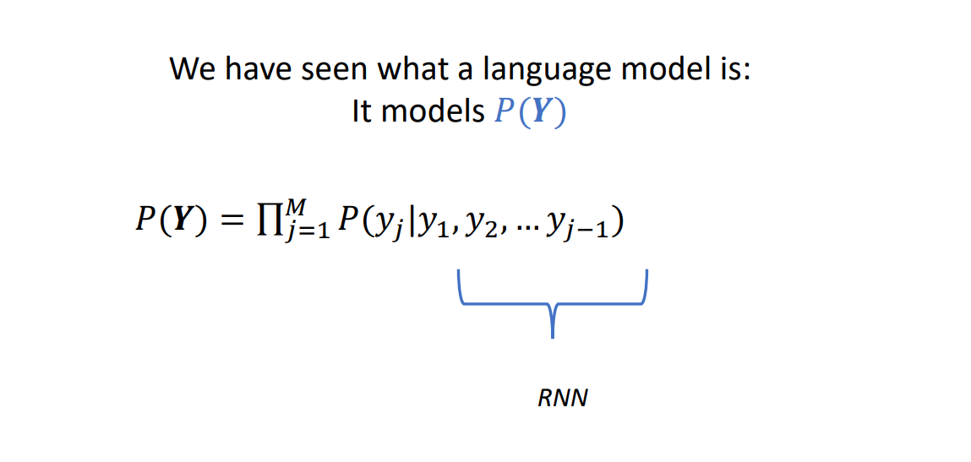

Slide 26
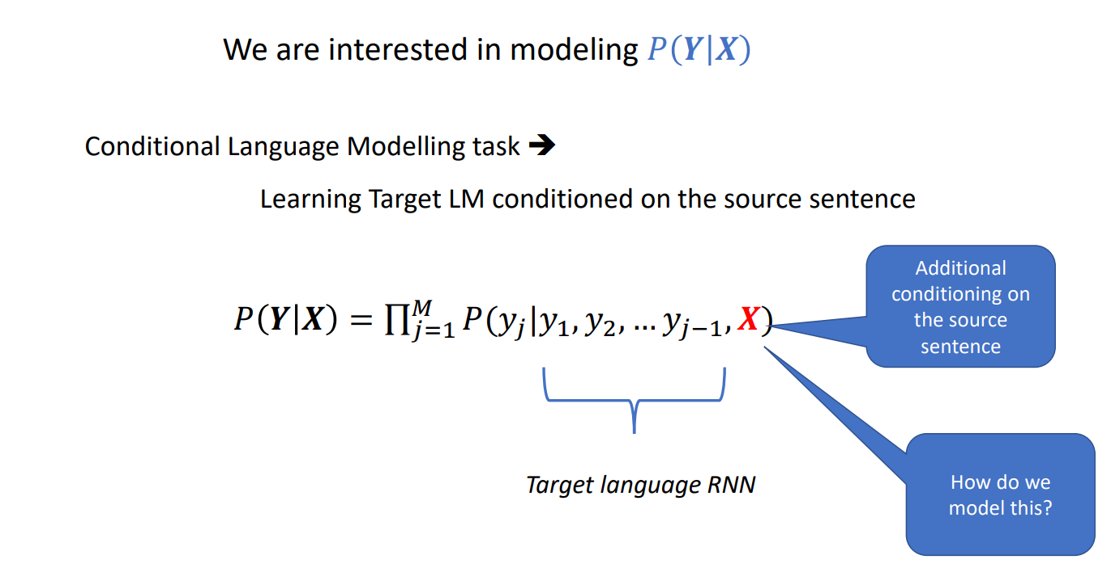

Slide 27
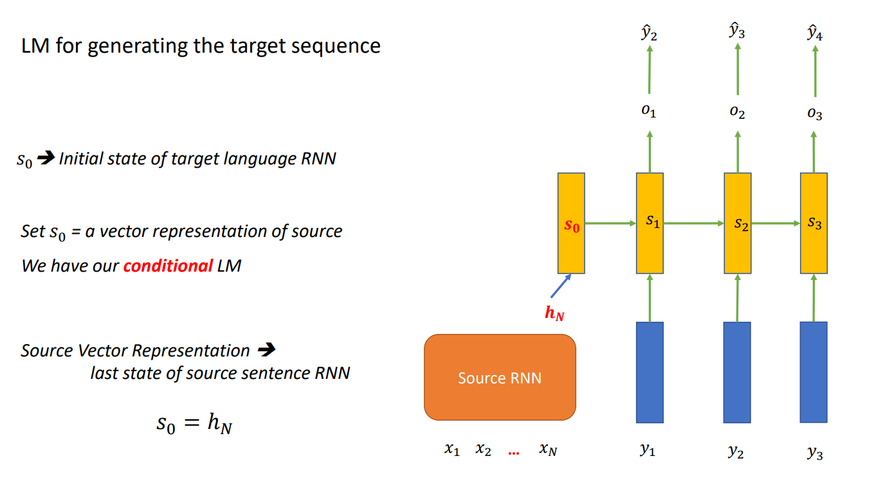

Slide 28
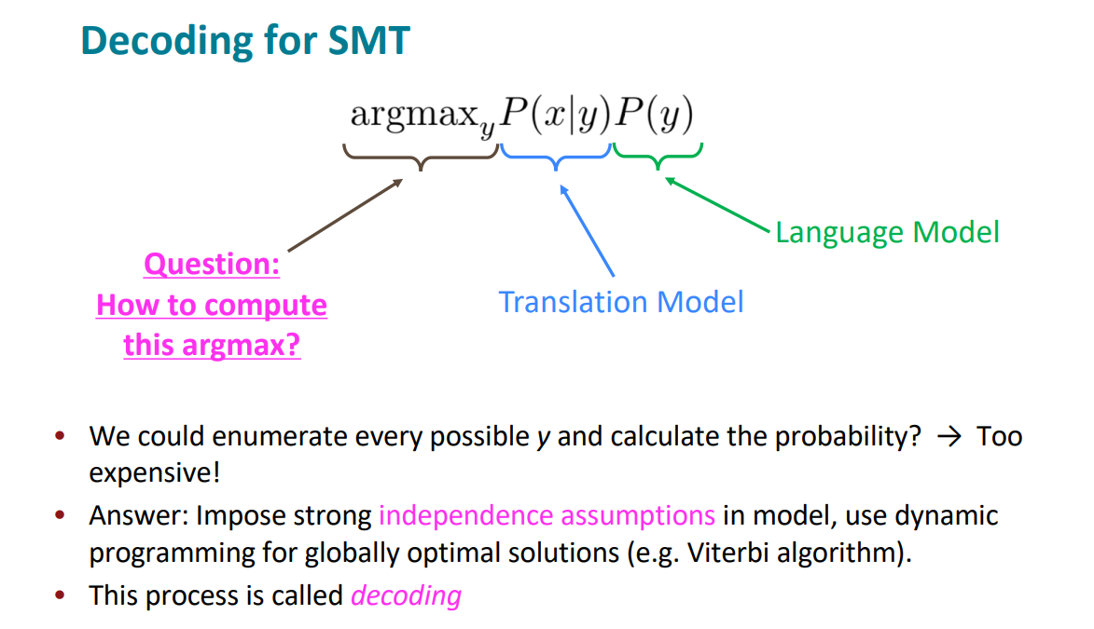

Slide 29
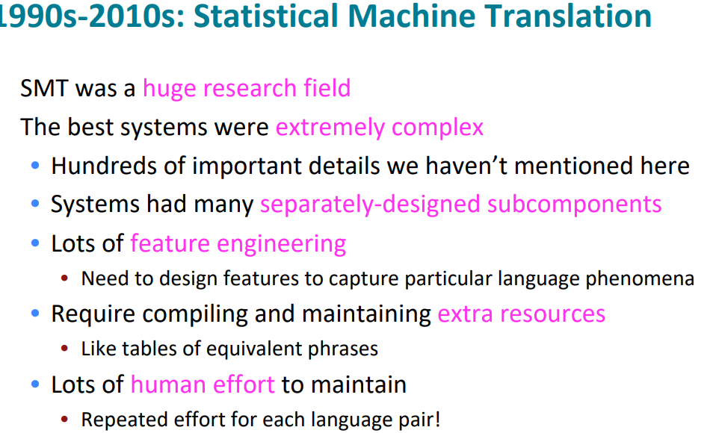

Slide 30
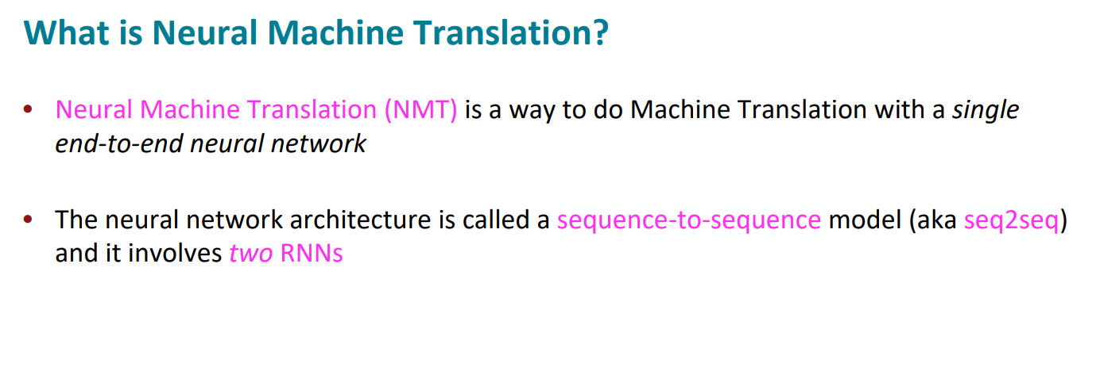

Slide 31
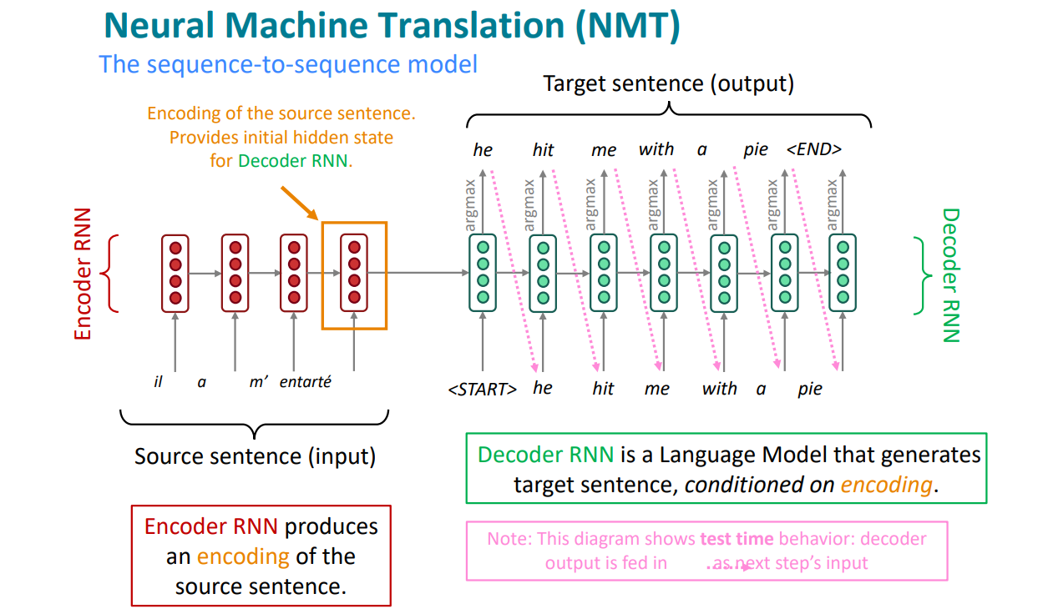

Slide 32
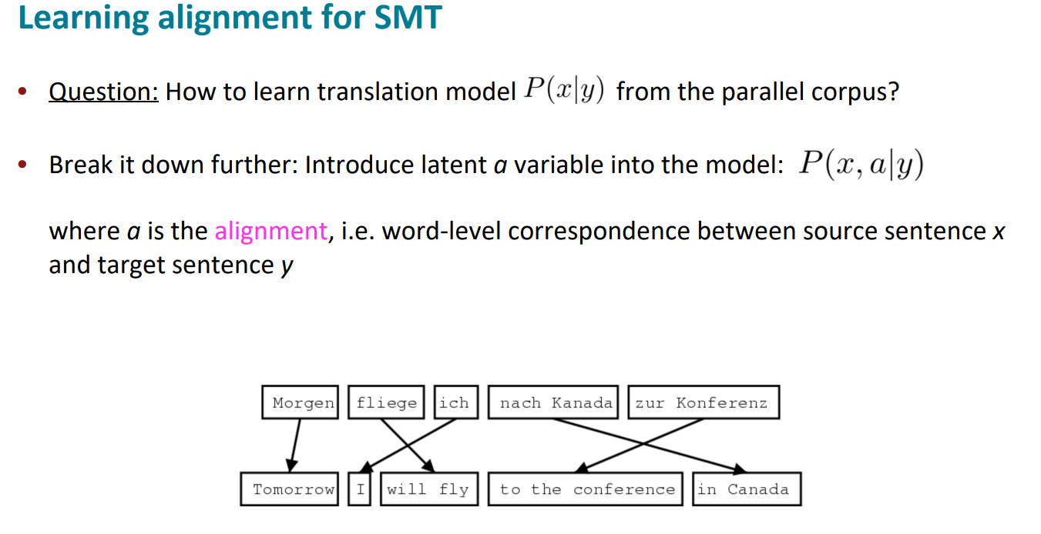

Slide 33
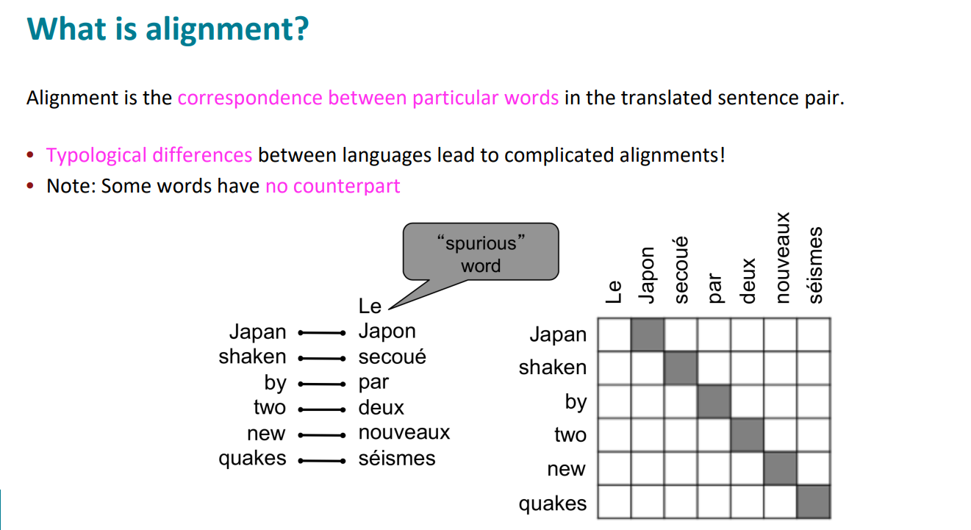

Slide 34
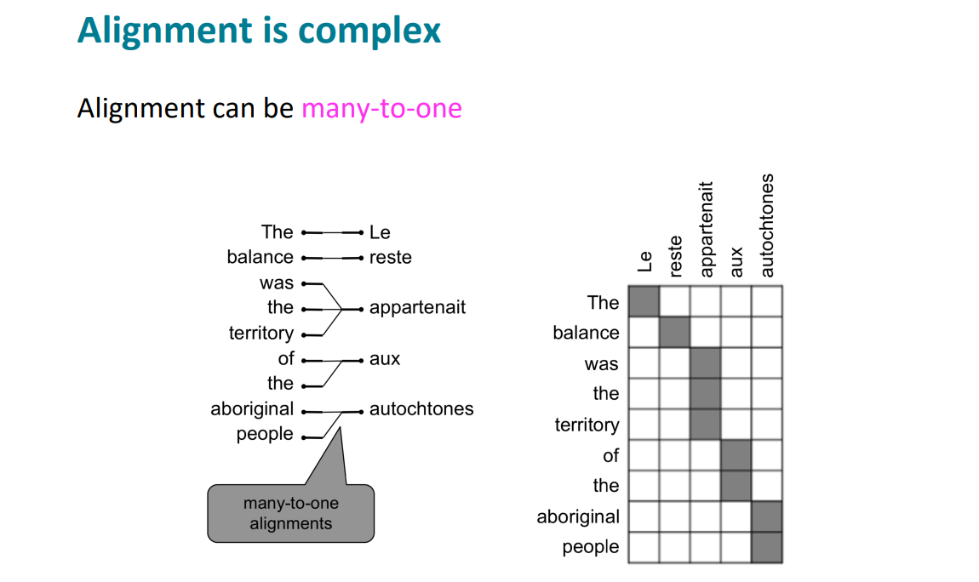
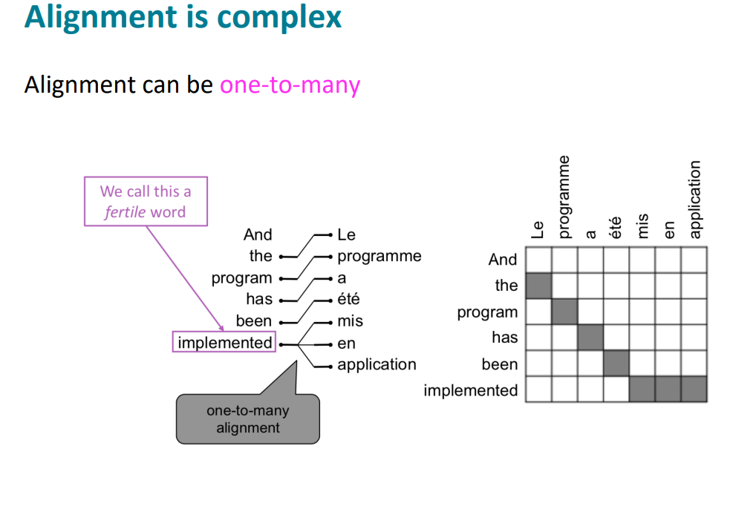

Slide 35
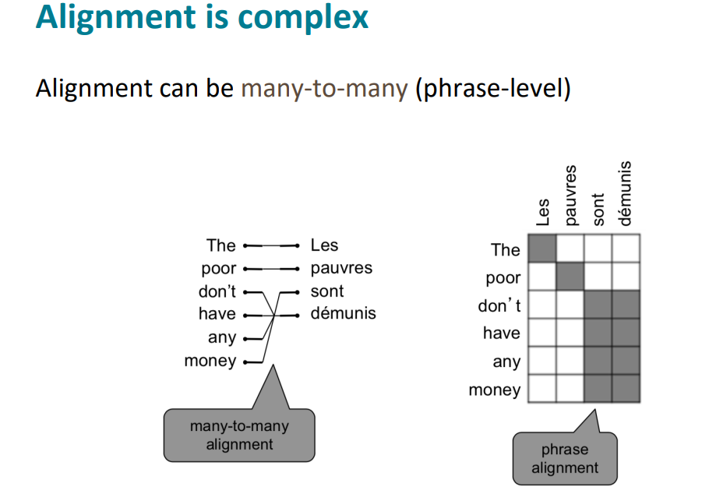

Slide 36
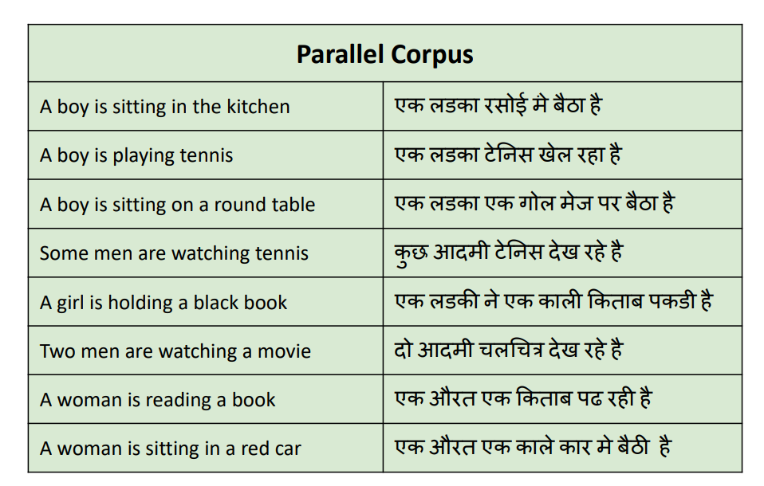
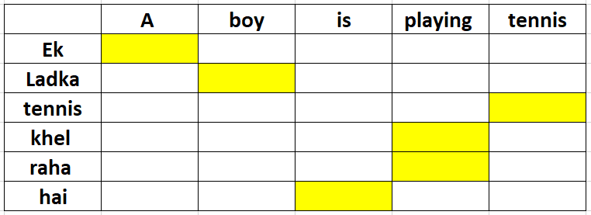

Slide 37
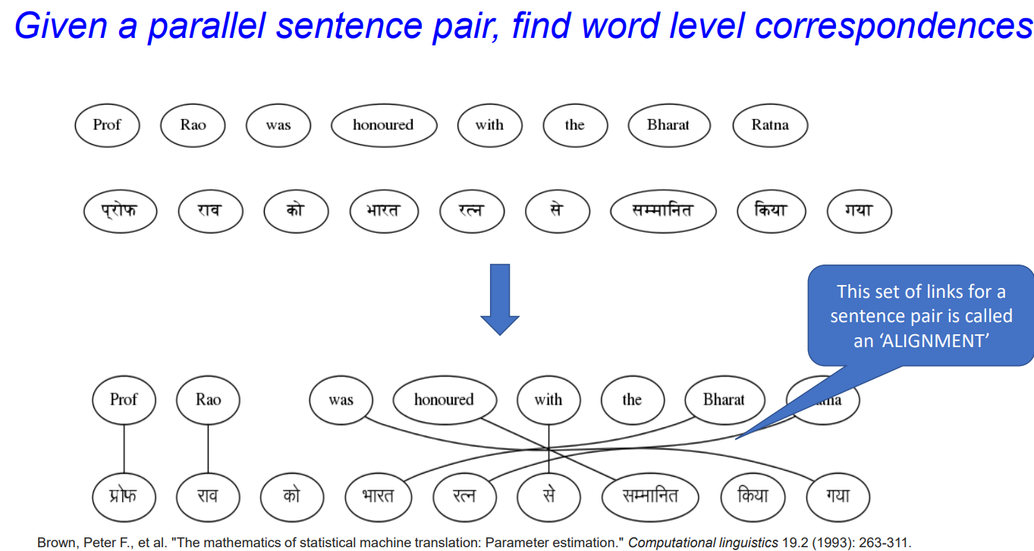

Slide 38
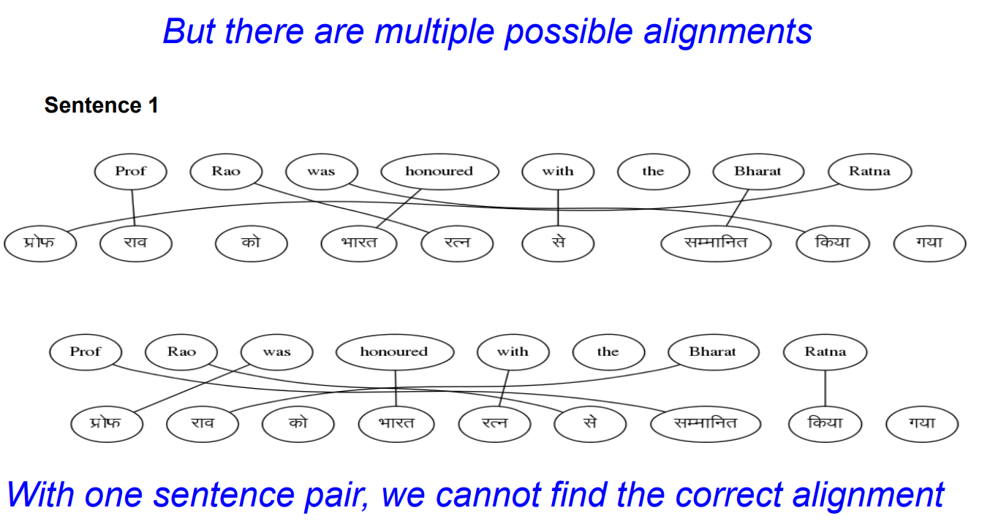

Slide 39
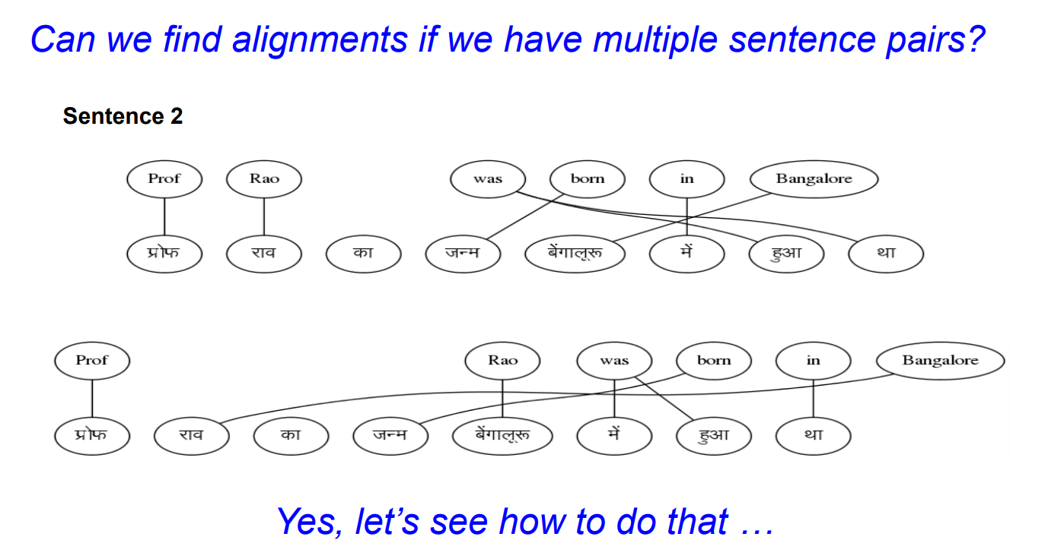

Slide 40
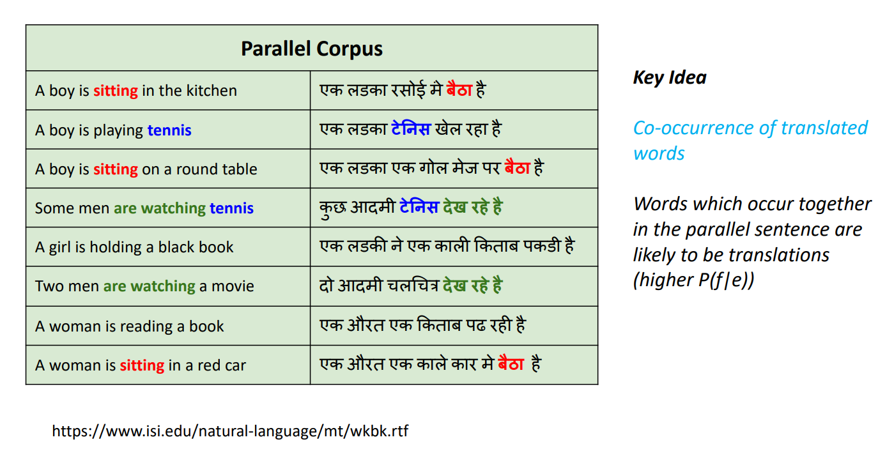

Slide 41
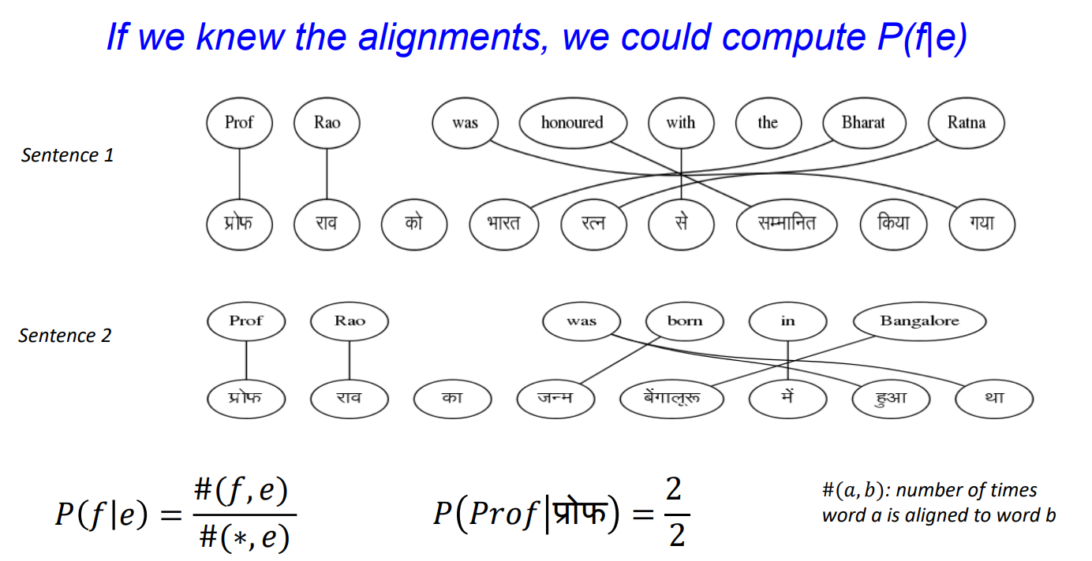

Slide 42
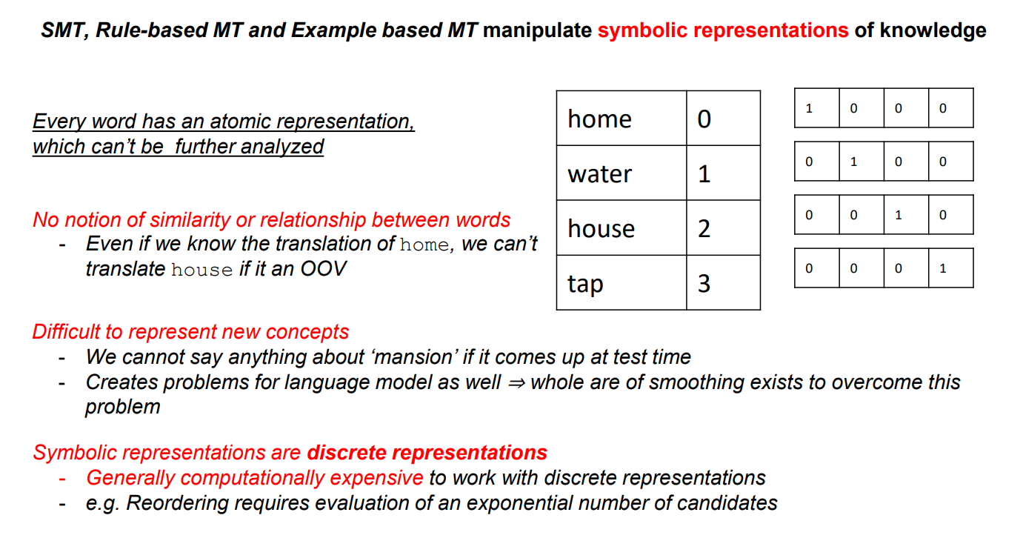

Slide 43
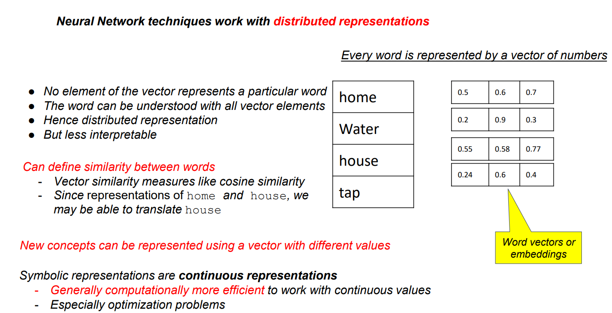

Slide 44
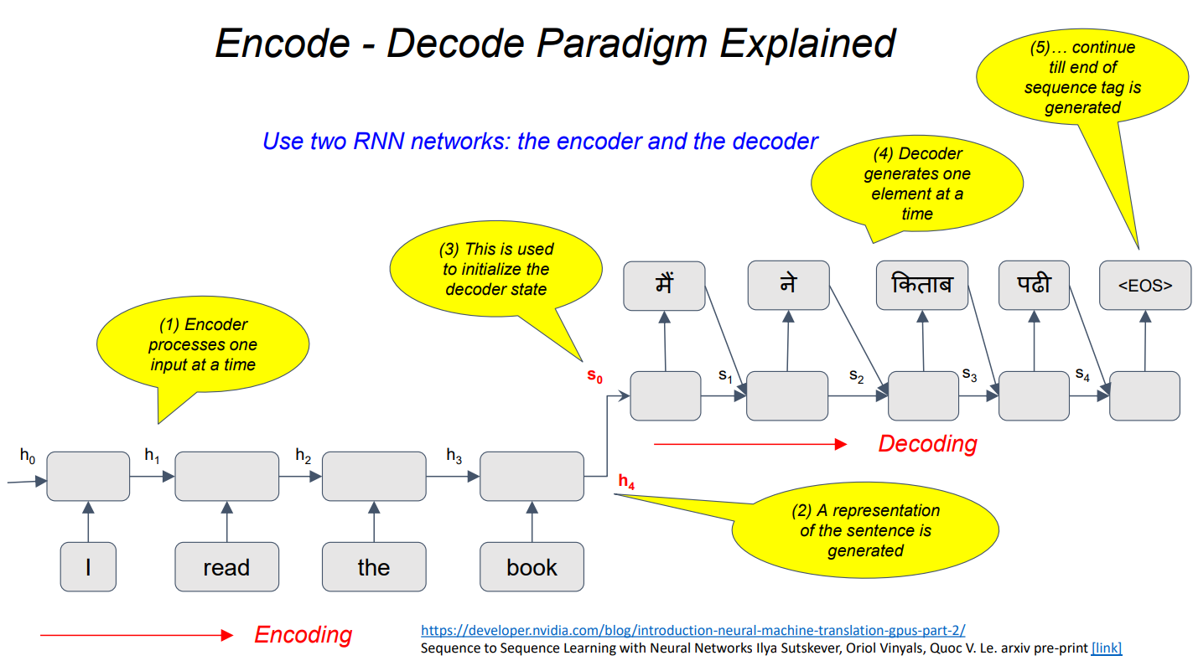

Slide 45
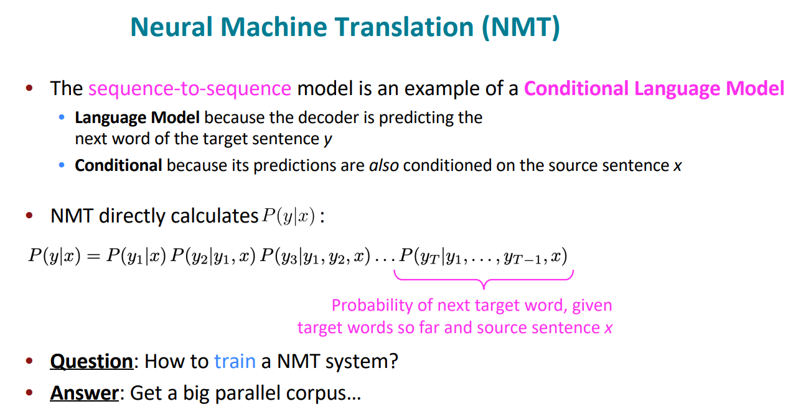

Slide 46
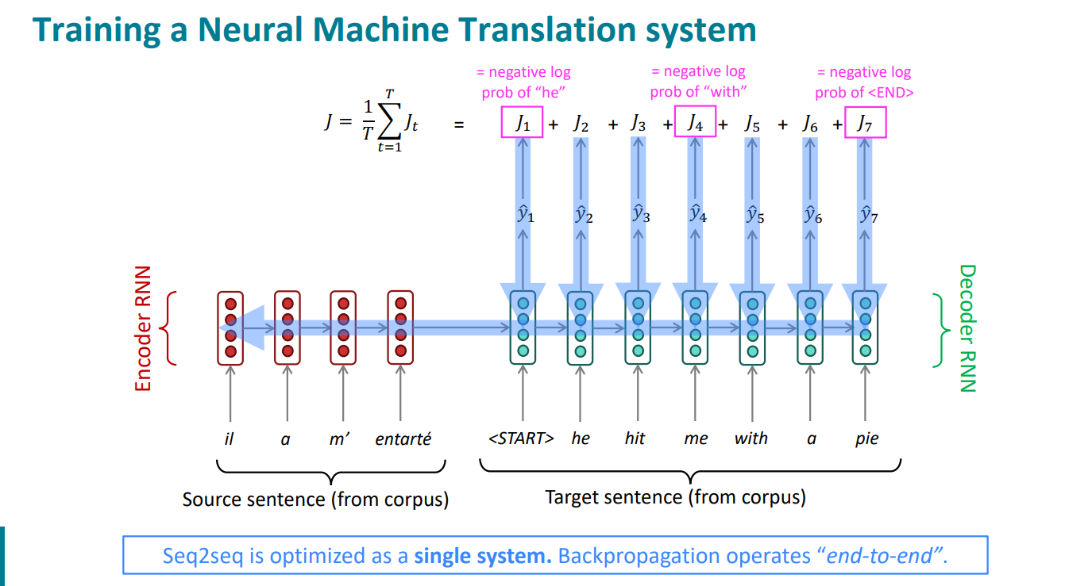

Slide 47
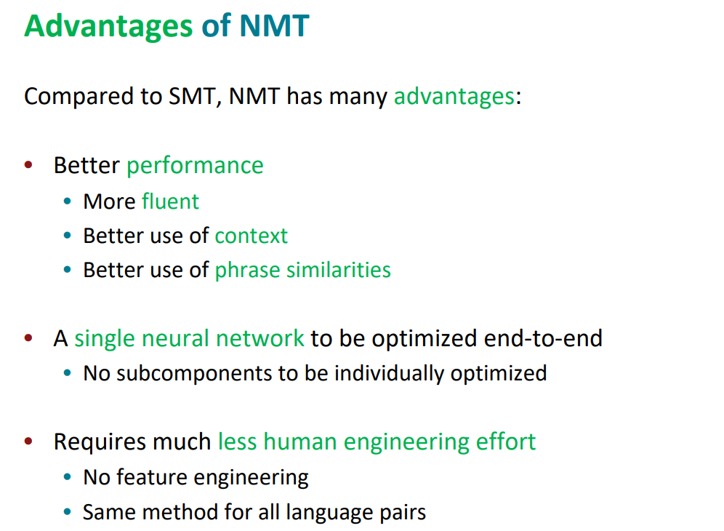

Slide 48





Slide 49


Slide 50


Slide 51
Which kind of data are needed for MT?
Issues with data
Parallel corpora (text in both languages)
Movies/videos (subtitiles)
Books / their translations
Wiki articles (weak) – comprabale corpora but not parallel
https://opus.nlpl.eu/
Noisy
Domain specific data (movie only, political only)
Language pairs are limited
Not aligned properly

Slide 52


Slide 53


Slide 54


Slide 55


Slide 56


Slide 57


Slide 58
Evaluation Measures

Slide 59
Evaluation
Is translation valid?
Subjective!! (different opinions)
Multiple references and then decide
Use objective measure : BLEU score

Slide 60


Slide 61


Slide 62


Slide 63


Slide 64


Slide 65


Slide 66


Slide 67
Reference: email was sent on Tuesday.
Candidate / Output: the letter was sent on Tuesday.
# unigrams in output: 6
# bigrams in output: 5
How many are correct?
Unigram: 4/6
Bigram: 3/5
Trigrams: 2/4
4-grams: 1/3

Slide 68
ZERO SHOT TRANSLATION
Train pair of languages on an encoder decoder architecture
Zero-shot machine translation is translation without parallel data between the source and target languages. Zero-shot translation is desirable because it can be too costly to create training data for each language pair. However, zero-shot models are typically lower quality than models trained from parallel data.
Input: English output:Japanese encodings can nicely work

Slide 69
Rule-based machine translation (RBMT): The earliest form of machine translation, rule-based MT, relied on a large, predefined set of linguistic rules that helped the software transfer the meaning of text between languages. Overall, it had low quality translation, and it required adding languages manually as well as a significant amount of human post-editing. Rule-based MT is rarely used today.
Statistical machine translation (SMT): Statistical MT builds a statistical model of the relationships between words, phrases, and sentences in a given text. It applies the model to a second language to convert those elements to the new language. Thereby, it improves on rule-based MT but shares many of the same issues. Statistical MT is mostly replaced by neural MT and is sometimes used for legacy machine translation systems.
Neural machine translation (NMT): Neural MT uses AI to “learn” languages and constantly improve its knowledge, much like the neural networks in the human brain. As opposed to running a set of predefined rules, an MT engine’s neural network is responsible for encoding and decoding the source text. Neural MT is more accurate, allows for adding more languages, and works much more quickly once trained—making it today’s standard in MT technology development.

